Slide 1

ATLIQ MART PROMOTIONS ANALYSIS
Created by : Pawan Pal
For project related files go to :
https://github.com/Pawan-Paul

Slide 2
Agenda
Problem Statement
Schema
Data Visualization
Ad – Hoc Requests
Recommended Insights

Slide 3
PROBLEM STATEMENT​
AtliQ Mart is a retail giant with over 50 supermarkets in the southern region of India. All their 50 stores ran a massive promotion during the Diwali 2023 and Sankranti 2024 (festive time in India) on their AtliQ branded products. Now the sales director wants to understand which promotions did well and which did not so that they can make informed decisions for their next promotional period.

Slide 4
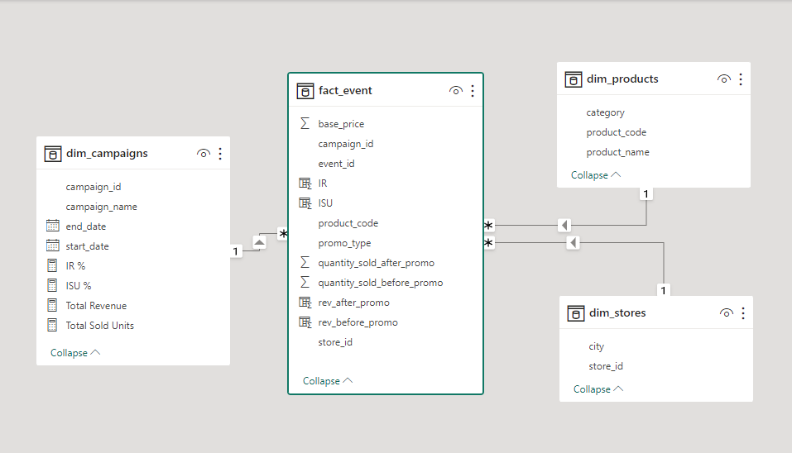
SCHEMA

Slide 5
Industry key terms
IR : Increment in Revenue after promotions
IR% : Percentage Increment in Revenue after promotion
ISU : Increment in Sold Units / Quantity after promotions
ISU% : Percentage Increment in Sold Units after promotions

Slide 6
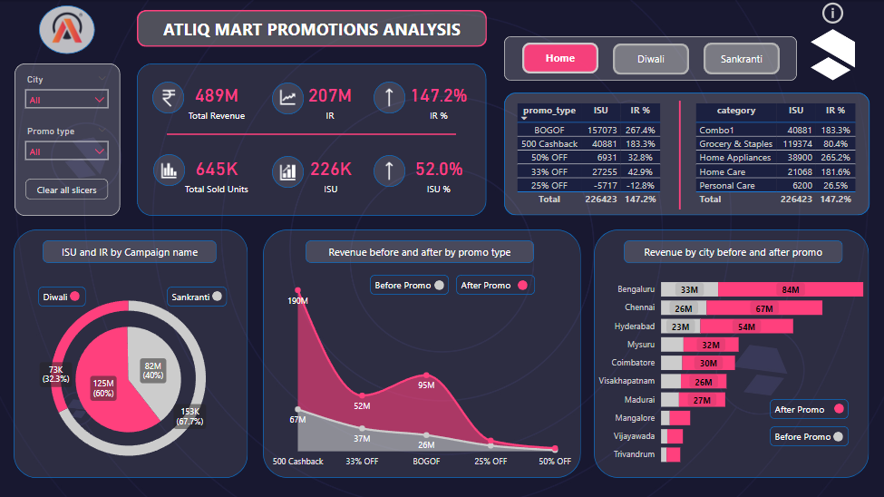
DATA VISUALISATION

Slide 7
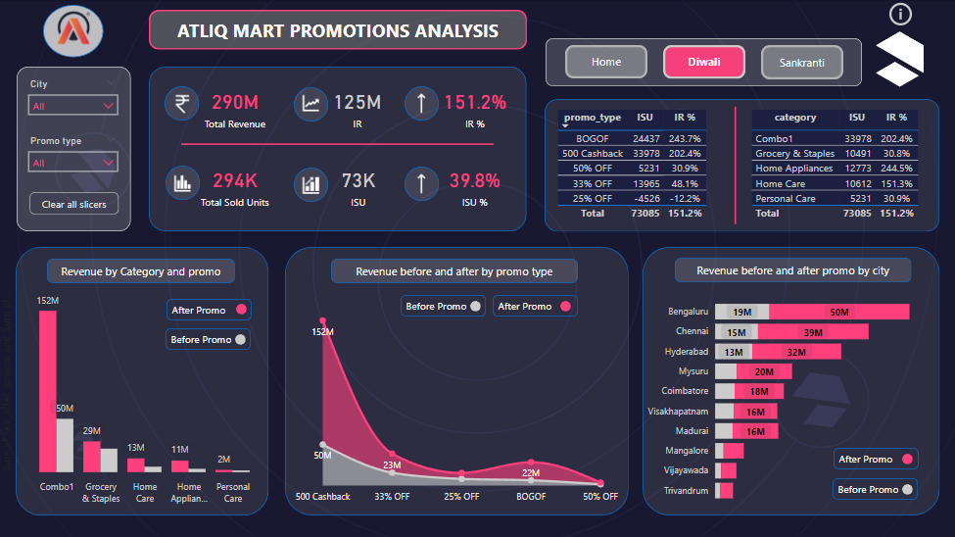
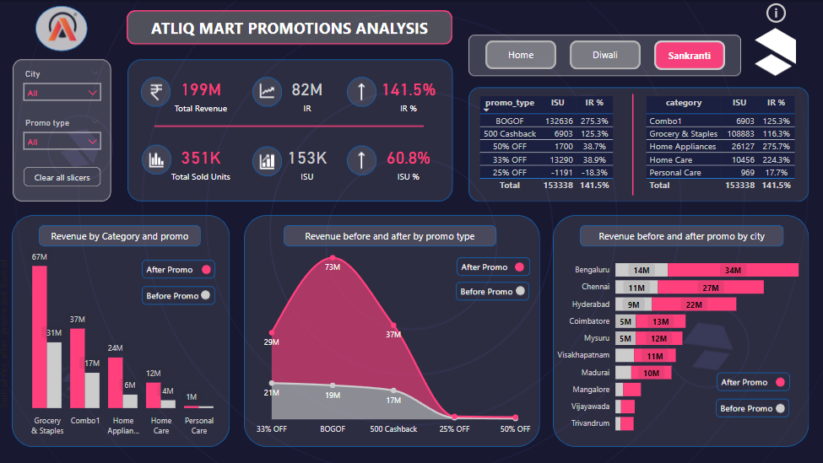

Slide 8
AD – HOC REQUESTS

Slide 9
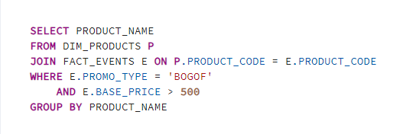

Q.1 Provide a list of products with base price greater than 500 and that are featured in promo type 'BOGOF'(Buy One Get One Free).

Slide 10
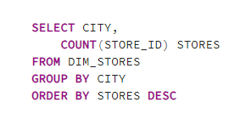
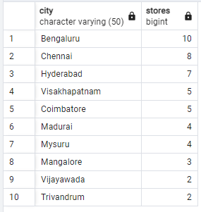
Q.2 Provide an overview of the number of stores in each city. The results will be sorted out in descending order of store counts.

Slide 11
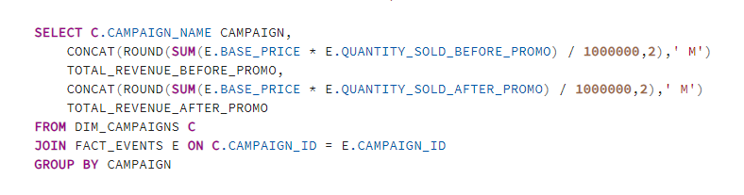

Q. 3 Provide each campaign along with the total revenue generated before and after campaign. Include three key fields : campaign name, total revenue (before promotion) and total revenue (after promotion). Display the values in millions.

Slide 12
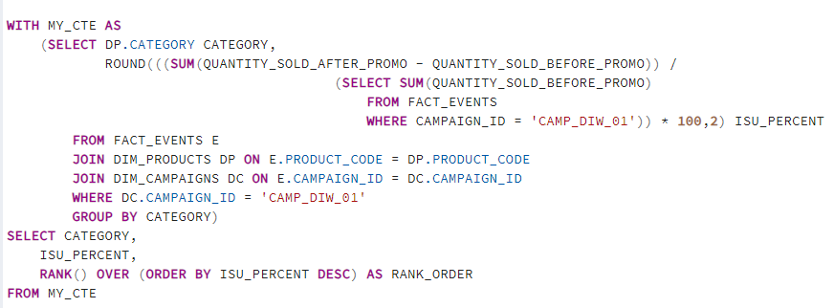
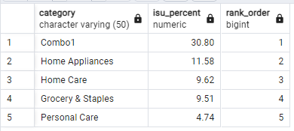
Q.4 Calculate the Incremental Sold Quantity (ISU%) for each category during the Diwali campaign. Also provide rankings for the categories based on their ISU%. The output will include three fields : Category, ISU%, rank order.

Slide 13
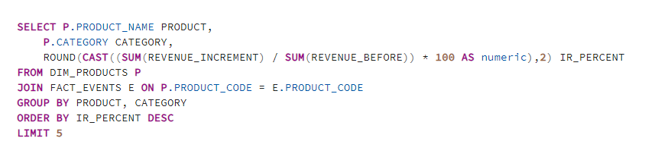
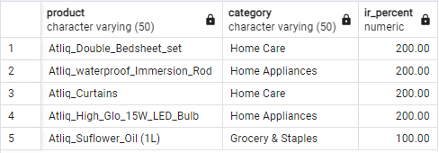
Q.5 Feature the top 5 products, ranked by incremental revenue percentage (IR%), across all campaigns.

Slide 14
Recommended insights

Slide 15
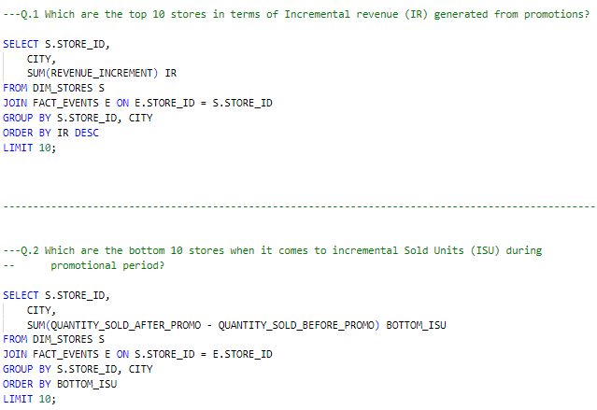
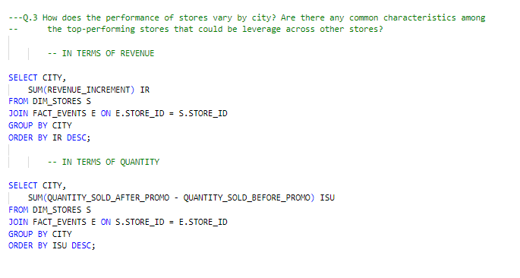
Store Performance Analysis

Slide 16
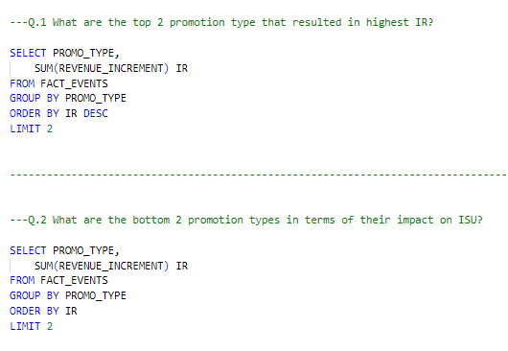
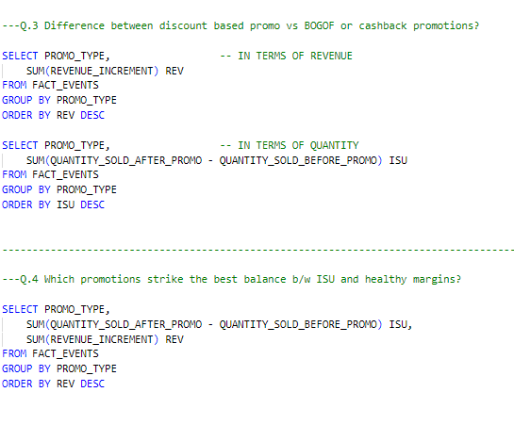
Promotions Analysis

Slide 17
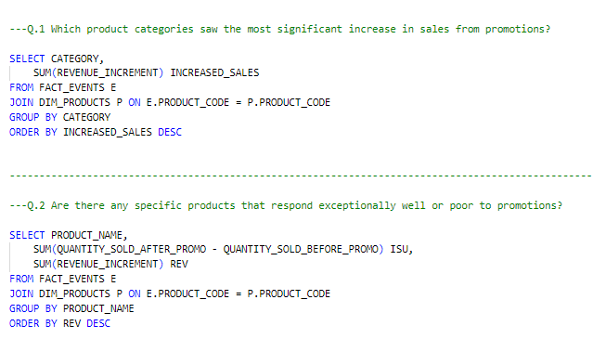
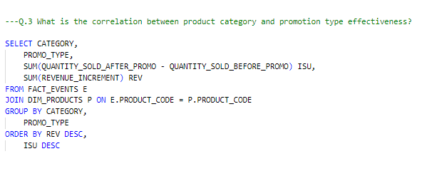
Product and category Analysis

Slide 18
THANK YOU
Pawan Pal
pawanpal.inbox@gmail.com
For more projects go to : https://github.com/Pawan-Paul

